Slide 1
Brahma, Vishnu and Shiva
Hindu Trinity

Slide 2
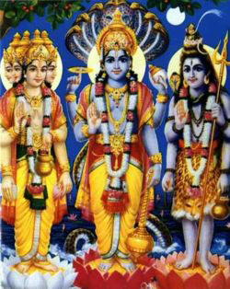
Lord Brahma, Lord Vishnu, Lord Shiva
Brahma
(Creator of the Universe)
Shiva
(Destroyer of the Universe)
Vishnu
(Preserver of the Universe)

Slide 3
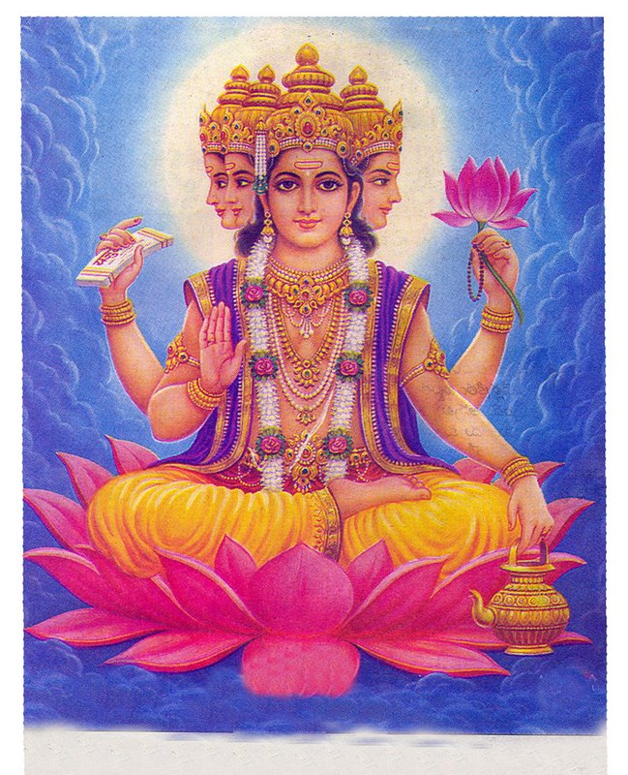
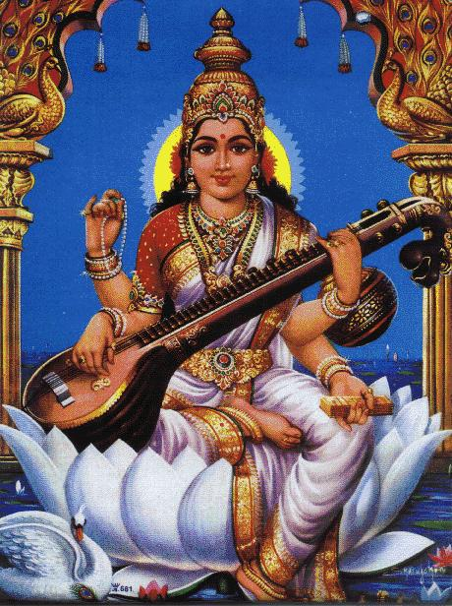
Lord Brahma and Saraswati
Brahma
Saraswati
(Goddess of Knowledge)
Brahma is said to be the Lord of creation. The creator must necessarily possess the knowledge to create. Without knowledge no creation is possible. Hence Brahma is said to be wedded to the goddess of knowledge, Saraswati.
Goddess Saraswati is the Goddess of Knowledge and refinement

Slide 4
Lord Brahma
Four Heads
Lotus Flower
Manuscript or Vedas
Rudraksha Mala
Lotus Flower
Kamandalu or water-pot

Slide 5
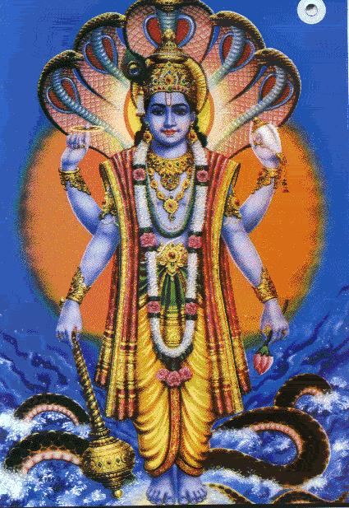
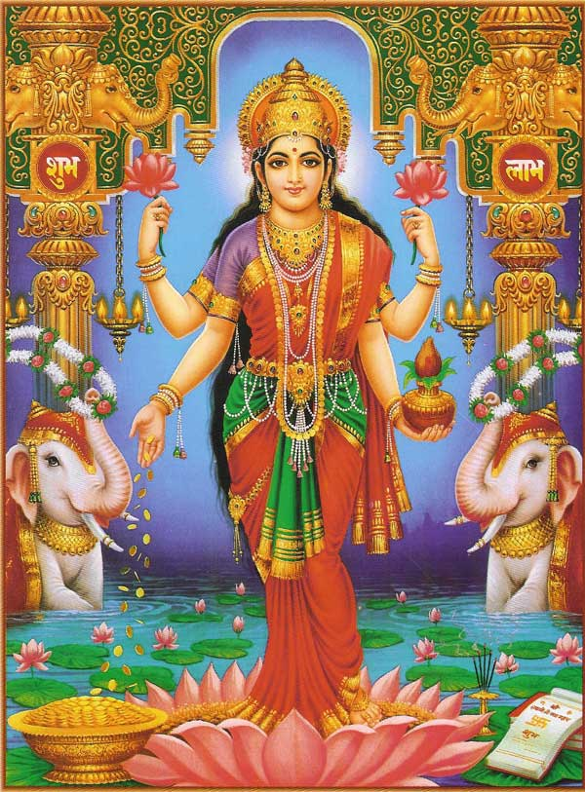
Lord Vishnu and Lakshmi
Vishnu
Lakshmi
Lord Vishnu, major god of Hinduism and Indian mythology, is popularly regarded as the preserver of the universe.
His wife is Goddess Lakshmi (also known as Shri), is goddess of fortune.

Slide 6
Lord Vishnu
Serpent (Shesha Nag)
Disc or Vaijra (chakra)
Conch or Sankha
Mace
Lotus or Padma

Slide 7
Lord Vishnu’s Avatars
Occasionally, the balance of power on earth between good and evil is upset in favor of evil, and then Lord Vishnu is believed to descend to earth in a mortal form (his avatar) to save humankind or the world.
Ten such avatars (descents or incarnations) are commonly recognized, of which Lord Rama and Lord Krishna are the most important. Nine descents are thought to have already occurred; the tenth and last is yet to come.
Nine avatars of Vishnu are:
Matsya or Fish incarnation
Kurma or Turtle incarnation
Varaha or Boar incarnation
Narasingha or Lion incarnation
Vamana or Dwarf incarnation
Parasurama
Ram
Krishna
Buddha
Kalki

Slide 8
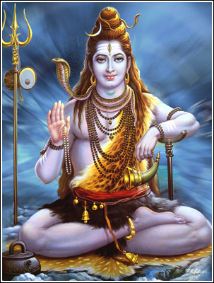
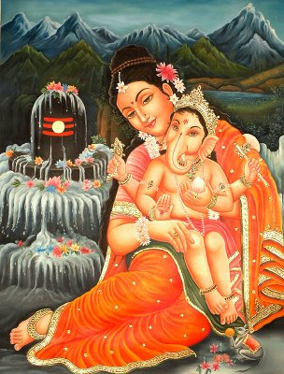
Lord Shiva and Parvati
Shiva
Parvati with Lord Ganesh
Shiva is one of the gods of the Trinity. He is said to be the god of destruction.
Shiva is married to the Goddess Uma or Parvati. Goddess Parvati represents Shakti.

Slide 9
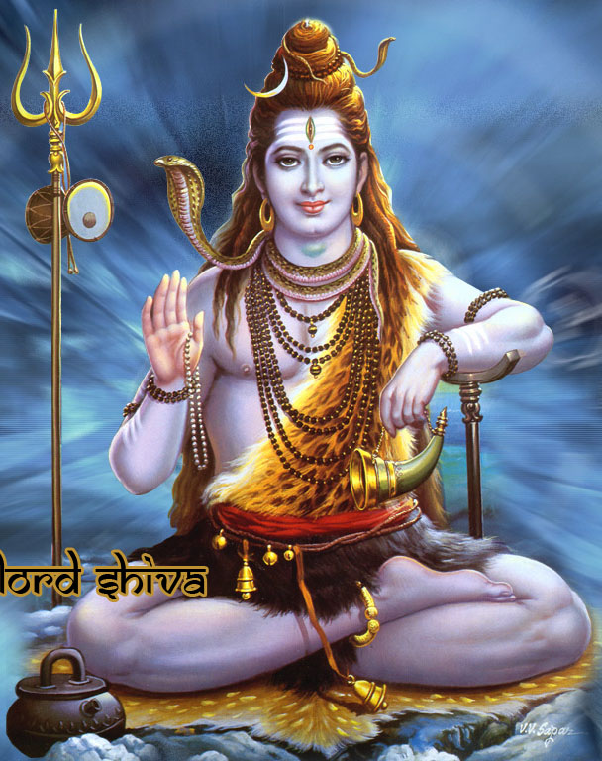
Lord Shiva- an ascetic
River Ganga
Trishul
Third eye
Snake around his neck
Blue Throat
Dhamru
Rudraksha Mala

